Slide 1

Writing Bad-News Messages
© Prentice Hall, 2004
Business Communication Essentials
Chapter 8 - ‹#›
Notes:
‹#›

Slide 2
Three-Step Writing Process
1
Planning
2
Writing
3
Completing
Analyze the
Situation
Organize the
Message
Revise the
Message
Investigate the
Topic
Compose the
Message
Produce the
Message
Adapt to the
Audience
Proofread the
Message
© Prentice Hall, 2004
Business Communication Essentials
Chapter 8 - ‹#›
Notes:
‹#›
You must be careful whenever you deliver bad news. The three-step process can help you write bad-news messages that are more effective.
Planning. If your purpose is specific, word it in the best possible way. You need to know how your audience will receive your message. Pay particular attention to maintaining a good relationship with your audience. Be sure to adapt your medium and tone to your audience. Use unmistakable facts to support your decision and have all the facts your audience will need.
Writing. The main idea in a bad-news message is a refusal, a rejection, or a negative announcement, so be careful to define that main idea and cover relevant points thoroughly and logically. Choosing between the direct and indirect approaches takes on added importance. Also, pay special attention to word choice so that you can create sentences and paragraphs that are tactful and diplomatic.
Completing. Revision is as important as the other steps in the writing process; it helps you make sure that your bad-news messages are organized properly, that they say what you want them to say, and that they do so concisely and clearly. You’ll want to make sure that your design is appropriate for the bad news and contributes to your efforts to be sensitive. And as always, proofreading bad-news messages guarantees that misunderstandings won’t arise from typos, errors in spelling, or problems with mechanics.

Slide 3
Strategies for Bad-News Messages
Convey the bad news
Gain acceptance for it
Maintain goodwill (As much as possible)
Promote a good corporate image
Minimize the need for future correspondence
© Prentice Hall, 2004
Business Communication Essentials
Chapter 8 - ‹#›
Notes:
‹#›
Whatever the details of your particular message, when you have bad news, you want your readers to feel that they have been taken seriously and to agree that your news is fair and reasonable.
When delivering bad news, you have five main goals:
1. Convey the bad news.
2. Gain acceptance for it.
3. Maintain as much goodwill as possible with your audience.
4. Maintain a good image for your organization.
5. Minimize the need for future correspondence on the matter.
Accomplishing so many goals in a single message is not easy. But you can make your bad-news messages effective by following these guidelines: First, adopt an audience-centered tone. Second, organize your message to meet your audience’s needs and expectations by using either the direct approach, which presents the main idea before the supporting data, or the indirect approach, which presents the supporting data before the main idea.

Slide 4

Audience-Centered Tone
The “You” Attitude
Positive Wording
Respectful Language
© Prentice Hall, 2004
Business Communication Essentials
Chapter 8 - ‹#›
Notes:
‹#›
It’s not what you say but how you say it that counts. That adage couldn’t be truer with bad-news messages. Your tone contributes to your message’s effectiveness by helping your readers to do the following:
Accept that your bad-news represents a firm decision.
Understand that your decision was fair and reasonable.
Remain well disposed toward your business.
Preserve their pride.
Experts suggest that you adopt an audience-centered tone by paying attention to these techniques:
Use the “you” attitude.
Choose positive words.
Use respectful language.

Slide 5
The Direct Approach
Flow of the Message
Bad News
Step 1
Reasons
Step 2
Positive
Close
Step 3
Substance of the Message
© Prentice Hall, 2004
Business Communication Essentials
Chapter 8 - ‹#›
Notes:
‹#›
If you know that your audience is likely to prefer the bad news first, or if the situation is minor and the news will cause your audience little pain or disappointment, use the direct approach:
Opening. Start with a clear statement of the bad news.
Body. Give reasons for the decision (perhaps offering alternatives).
Close. End with a positive statement; strive to maintain goodwill.
Stating the bad news at the beginning can have two advantages:
1. It makes a shorter message possible.
2. The audience needs less time to reach the main idea of the message.
You may want to use the direct approach in a variety of circumstances, saving your positive comments for the close. Even so, remember that a tactful tone and a focus on reasons will help make any bad-news message easier to accept.

Slide 6
The Indirect Approach
Flow of the Message
Buffer
Step 1
Reasons
Step 2
Bad
News
Step 3
Positive
Close
Step 4
Substance of the Message
© Prentice Hall, 2004
Business Communication Essentials
Chapter 8 - ‹#›
Notes:
‹#›
Beginning a bad news message with a blunt “no” could well prevent people who prefer an explanation first from reading or listening to your reasons. For such audiences, the indirect approach is appropriate. This approach eases the audience into your message by explaining your reasons before giving them the bad news. Presenting the reasons first increases the chances of your gaining audience acceptance by gradually preparing them for the negative news.
The indirect approach follows a four-part sequence:
1. Open with a buffer.
2. Continue with a logical, neutral explanation of the reasons for the news.
3. Follow with a clear but diplomatic statement of the bad news.
4. Close with a positive forward-looking statement.
The next four slides cover this four-part sequence in detail.

Slide 7
Questions to ask…
Will the bad news come as a shock?
Does the reader prefer short messages that get right to the point?
How important is this news to the reader?
Do you need to maintain a close working relationship with the reader?
Do you need to get the reader’s attention? If someone has ignored repeated messages, the direct approach can help you get his or her attention
What is your organization’s preferred style?
© Prentice Hall, 2004
Business Communication Essentials
Chapter 8 - ‹#›

Slide 8
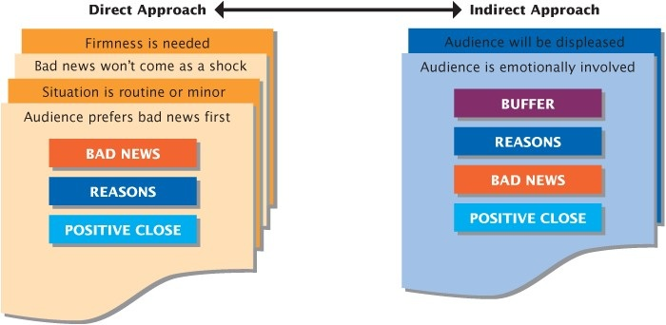
Which one to use?
© Prentice Hall, 2004
Business Communication Essentials
Chapter 8 - ‹#›

Slide 9


Begin With a Buffer
Sincere
(No excessive flattery!)
Relevant
Not Misleading
(Avoid implying signs
of good news!)
Neutral (Avoid saying
straight no!)
© Prentice Hall, 2004
Business Communication Essentials
Chapter 8 - ‹#›
Notes:
‹#›
A buffer is a neutral, non-controversial statement that is closely related to the point of the message. A good buffer expresses your appreciation for being thought of, assures the reader of your attention to the request, compliments the reader, or indicates your understanding of the reader’s needs. The following advice can help you to write effective buffers:
Sincere. Never insult your audience with insincere flattery or self-promoting blather. An effective buffer never makes readers feel they are being set up or “snowed.”
Relevant. Don’t use an unrelated buffer. You will seem to be avoiding the issue. You'll appear manipulative and unethical, and you’ll lose your audience's respect.
Not misleading. Avoid implying that good news will follow. Building up your audience’s expectations at the beginning only makes the actual bad news even more surprising.
Neutral. Avoid saying “no.” An audience encountering the refusal at the beginning usually reacts negatively to the rest of the message, no matter how reasonable and well phrased it is.

Slide 10
Begin With a Buffer
Respectful
(Avoid using a know-it-all tone
like “You should know that”)
Succinct
Assertive
(Avoid apologizing!)
Brief
© Prentice Hall, 2004
Business Communication Essentials
Chapter 8 - ‹#›
Notes:
‹#›
Respectful. Avoid using a know-it-all tone. When you use phrases such as "you should be aware that," readers expect your lecture to lead to a negative response, so they resist the rest of your message.
Succinct. Avoid wordy and irrelevant phrases and sentences. Sentences such "We are writing in response to your request" are irrelevant. Make better use of the space by referring directly to the subject of the letter.
Assertive. Avoid apologizing. Unless warranted by extreme circumstances, an apology only weakens the following explanation of your unfavorable news.
Brief. Avoid writing a buffer that is too long. Be brief. Find something that you and your audience can agree on before proceeding in a businesslike way.

Slide 11
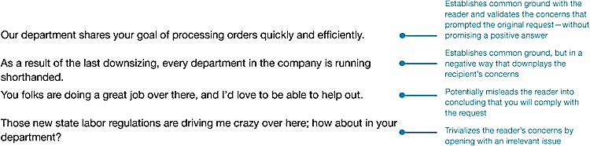

Examples of Buffer
Not so good Examples
Good Example
© Prentice Hall, 2004
Business Communication Essentials
Chapter 8 - ‹#›
Notes:
‹#›

Slide 12
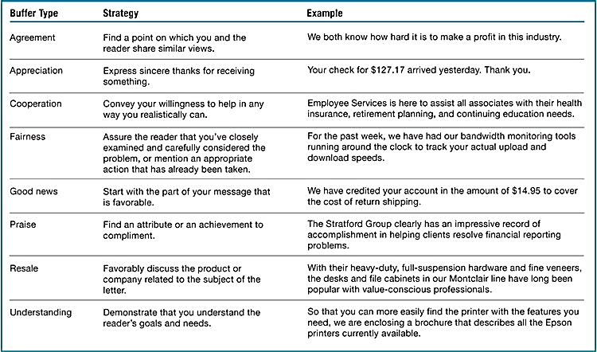
Different ways to use buffer
© Prentice Hall, 2004
Business Communication Essentials
Chapter 8 - ‹#›

Slide 13

Provide Reasons That Support the Refusal
Cover positive points
Provide relevant details
Highlight benefits
Minimize the word “company policy”
Avoid apologizing
© Prentice Hall, 2004
Business Communication Essentials
Chapter 8 - ‹#›
Notes:
‹#›
If you've done a good job of composing the buffer, the reasons will follow naturally. Cover the more positive points first; then move to the less positive ones. Provide enough detail for the audience to understand your reasons, but be concise; a long, roundabout explanation may make your audience impatient. Your goal is to explain why you have reached your decision before you explain what that decision is. If you present your reasons effectively, they should convince your audience that your decision is justified, fair, and logical.
One way to be tactful is to highlight how your negative decision benefits your readers (rather than focusing on why the decision is good for you or your company). Facts and figures are often helpful in convincing members of your audience that you're acting in their best interests.
Avoid hiding behind company policy to cushion the bad news. Skilled and sympathetic communicators explain company policy (without referring to it as “policy”) so that the audience can try to meet the requirements at a later time.
Similarly, avoid apologizing when giving your reasons. Apologies are appropriate only when someone in your company has made a severe mistake or has done something terribly wrong. If no one in the company is at fault, an apology gives the wrong impression.

Slide 14

State the Message
De-emphasize the Bad News
Use a Conditional Statement (if or when) statement
Focus on the Positive
(What you did do, can do, or will do rather than what you did not do,
cannot do, or will not do)
BUT!!! Avoid Overly Blunt Language
(Negative message must be clear!)
© Prentice Hall, 2004
Business Communication Essentials
Chapter 8 - ‹#›
Notes:
‹#›
The following techniques are especially useful for saying no as clearly and as kindly as possible.
First, de-emphasize the bad news:
Minimize the space or time devoted to the bad news.
Subordinate bad news in a complex or compound sentence.
Embed bad news in the middle of a paragraph or use parenthetical expressions.
Second, use a conditional (if or when) statement to imply that the audience could have received, or might someday receive, a favorable answer.
Third, tell the audience what you did do, can do, or will do rather than what you did not do, cannot do, or will not do. By focusing on the positive and implying the bad news, you soften the blow.
When implying bad news, be sure your audience understands the entire message—including the bad news. It would be unethical to overemphasize the positive. So if an implied message might leave doubt, state your decision in direct terms. Just be sure to avoid overly blunt statements that are likely to cause pain and anger.

Slide 15
Close With Confidence
Keep it positive. Don't refer to, repeat, or apologize for the bad news, and refrain from expressing any doubt that your reasons will be accepted (avoid statements such as "I trust our decision is satisfactory").
Limit future correspondence. Encourage additional communication only if you're willing to discuss your decision further (avoid wording such as "If you have further questions, please write").
Be optimistic about the future. Don’t anticipate problems (avoid statements such as "Should you have further problems, please let us know").
Be sincere. Steer clear of clichés that are insincere in view of the bad news (avoid saying, "If we can be of any help, please contact us").
Notes:
‹#›
After giving your audience the bad news, your job is to end your message on an upbeat note. You might propose an attainable solution to the audience's problem. In a message to a customer or potential customer, an off-the-subject ending that includes resale information or sales promotion may also be appropriate. If you've asked readers to decide between alternatives or to take some action, make sure that they know what to do, when to do it, and how to do it with ease. Whatever type of close you choose, follow these guidelines:
Keep it positive. Don't refer to, repeat, or apologize for the bad news, and refrain from expressing any doubt that your reasons will be accepted (avoid statements such as "I trust our decision is satisfactory").
Limit future correspondence. Encourage additional communication only if you're willing to discuss your decision further (avoid wording such as "If you have further questions, please write").
Be optimistic about the future. Don’t anticipate problems (avoid statements such as "Should you have further problems, please let us know").
Be sincere. Steer clear of clichés that are insincere in view of the bad news (avoid saying, "If we can be of any help, please contact us").

Slide 16

Writing Bad-News Messages
Routine requests
Organizational news
Employment information
© Prentice Hall, 2004
Business Communication Essentials
Chapter 8 - ‹#›
Notes:
‹#›
In the course of your business career, you will write various types of bad-news messages, from refusing credit to giving negative performance reviews. Many of the messages that you’ll be writing will probably fall into three major categories: negative answers to routine requests, negative organizational news, and negative employment messages.

Slide 17
Routine Workplace Requests
Business
Information
Invitations
and Favors
© Prentice Hall, 2004
Business Communication Essentials
Chapter 8 - ‹#›
Notes:
‹#›
The businessperson who tries to say “yes” to everyone probably won’t win many promotions or stay in business for long. Occasionally, your response to routine requests must simply be “no.” Only a skilled communicator can say “no” clearly, without being offensive.
When people ask you for information and you can't honor the request, you may answer with either the direct approach or the indirect approach. Your wording and tone conspire to make the letter either offensive or acceptable.
When you must say “no” to an invitation or a requested favor, your use of the direct or the indirect approach depends on your relationship with the reader. If you don't know the person well, you'll probably use the indirect approach. If know the person well or work with him or her often, you might be more direct.

Slide 18
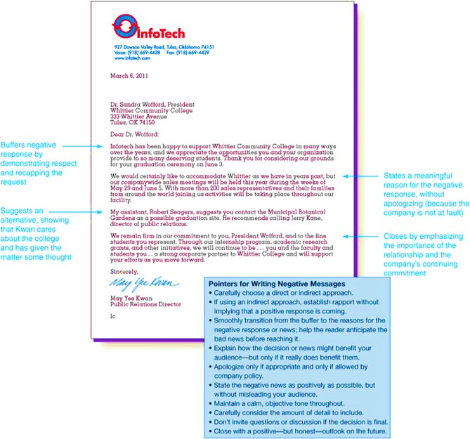
© Prentice Hall, 2004
Business Communication Essentials
Chapter 8 - ‹#›

Slide 19
The Status of Orders
Ship Part
of the Order
Ship None
of the Order
© Prentice Hall, 2004
Business Communication Essentials
Chapter 8 - ‹#›
Notes:
‹#›
When delivering bad news to existing or would-be customers, you have an additional challenge—resale. To make readers feel good about continuing to do business with your firm, you want to do the following:
Work toward an eventual sale along the lines of the original order.
Keep instructions or additional information as clear as possible.
Maintain an optimistic, confident tone to keep the reader interested.
Reinforcing the customer’s confidence in your service or product is an effective way to meet the resale challenge. Just don’t overdo it.
When you must back order for a customer, you have one of two types of bad news to convey: (1) You're able to send only part of the order, or (2) you're able to send none of the order. When sending part of the order, you actually have good news and bad news. Use the indirect approach, in such situations. The buffer contains the good news (that part of the order is en route) along with a resale reminder of the product's attractiveness. The reasons why part of the shipment is delayed come next. A strong close encourages a favorable attitude toward the entire transaction.
When you're unable to send the customer any portion of an order, you still use the indirect approach. However, because you have no good news to give, your buffer only confirms the sale, and the explanation section states your reasons for not filling the order promptly.
If you’ve failed to meet expectations that you set for the customer, an element of apology should be considered

Slide 20
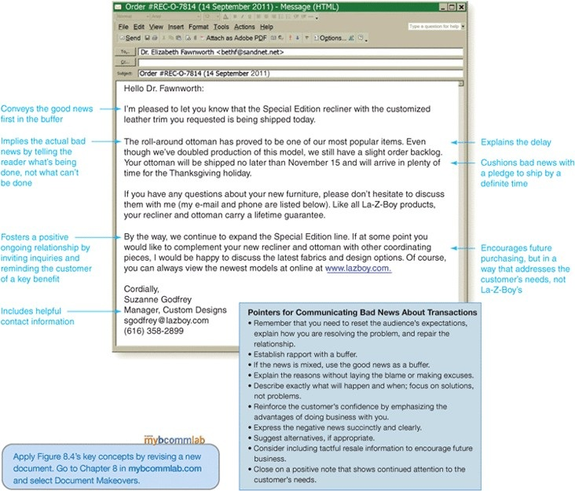
© Prentice Hall, 2004
Business Communication Essentials
Chapter 8 - ‹#›

Slide 21

Claims and Adjustments
Things to Employ
Things to Avoid
Courtesy and Tact
Accepting Blame
Indirect Approach
Accusations
Understanding
Negative Language
Possible Alternatives
Defamation (Calling a
person fraud!)
© Prentice Hall, 2004
Business Communication Essentials
Chapter 8 - ‹#›
Notes:
‹#›
Almost every customer who makes a claim is emotionally involved; therefore, the indirect approach is usually the best approach for a refusal. Your job as a writer is to avoid accepting responsibility for the unfortunate situation and yet avoid blaming or accusing the customer. To steer clear of these pitfalls, pay special attention to the tone of your letter. Keep in mind that a tactful and courteous letter can build goodwill even while denying the claim.
Avoid language that might have a negative impact on the reader. Instead, demonstrate that you understand and have considered the complaint. Then, even if the claim is unreasonable, rationally explain why you are refusing the request. Remember, don't apologize and don’t rely on company policy. End the letter on a respectful and action-oriented note.
You may be tempted to respond to something particularly outrageous by calling the person responsible a crook, a swindler, or an incompetent. Resist! If you don't, you could be sued for defamation, a false statement that tends to damage someone's character or reputation.

Slide 22
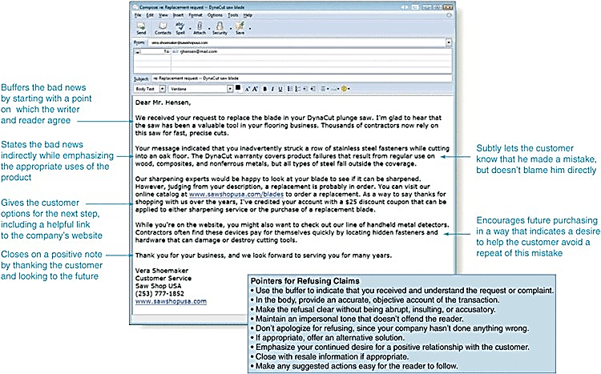
© Prentice Hall, 2004
Business Communication Essentials
Chapter 8 - ‹#›

Slide 23

Organizational News
Products
Operations
© Prentice Hall, 2004
Business Communication Essentials
Chapter 8 - ‹#›
Notes:
‹#›
At times, you may have bad news about your company’s products or about its operations. Whether you’re reporting to a supervisor or announcing your news to the media, the particular situation dictates whether you will use the direct or the indirect approach.
Say that you must provide bad news about a product. If you were writing to tell your company's bookkeeping department about increasing product prices, you'd use the direct approach. On the other hand, if you were writing to convey the same information to customers or even to your own sales department, you would probably use the indirect approach.
At least three situations require bad-news letters about company operations or performance: (1) a change in company policy or future plans that will have a negative effect on the reader, (2) problems with company performance, and (3) controversial or unpopular company operations. If an apology is appropriate, good writers usually make it brief and bury it somewhere in the middle of the letter. Moreover, they try to leave readers with a favorable impression by closing on a positive note.

Slide 24
Letters of Recommendation
Requested
by Businesses
Requested
by Individuals
Be Direct
State Facts
Practice
Diplomacy
Recognize
Feelings
© Prentice Hall, 2004
Business Communication Essentials
Chapter 8 - ‹#›
Notes:
‹#›
Even though many states have passed laws to protect employers who provide open and honest job references for former employees, legal hazards persist. That's why many former employers still refuse to write recommendation letters—especially for people whose job performance has been unsatisfactory. When sending refusals to prospective employers, your message may be brief and direct.
Letters to the applicants themselves are another matter. Any refusal to cooperate may seem a personal slight and a threat to the applicant's future. Diplomacy and preparation help readers accept your refusal.

Slide 25
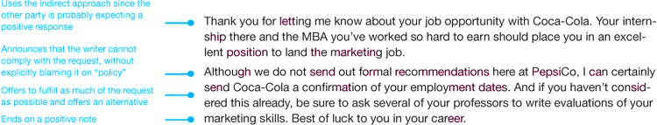
© Prentice Hall, 2004
Business Communication Essentials
Chapter 8 - ‹#›

Slide 26

Employment Applications
Use a
Direct Approach
State Reasons
Clearly
Suggest
Alternatives
© Prentice Hall, 2004
Business Communication Essentials
Chapter 8 - ‹#›
Notes:
‹#›
It's also difficult to tactfully tell job applicants that you won’t be offering them employment. But don't let the difficulty stop you from communicating the bad news. Rejecting an applicant with silence is unacceptable. At the same time, poorly written rejection letters do have negative consequences, ranging from the loss of qualified candidates for future openings to the loss of potential customers (not only the rejected applicants but also their friends and family). When delivering bad news to job applicants, follow three guidelines:
Open with the direct approach. A recent study by the Journal of Business and Technical Communication shows businesses fare better when they reject applicants up-front. If you try to buffer the bad news that your reader is expecting, you will seem manipulative and insincere.
Clearly state why the applicant was not selected. Make your rejection less personal by stating that you hired someone with more experience or whose qualifications match the position requirements more closely.
Close by suggesting alternatives. If you believe the applicant is qualified, mention other openings within your company. You might suggest professional organizations that could help the applicant find employment. Or you might simply mention that the applicant's résumé will be considered for future openings. Any of these positive suggestions may help the applicant be less disappointed and view your company more positively.

Slide 27
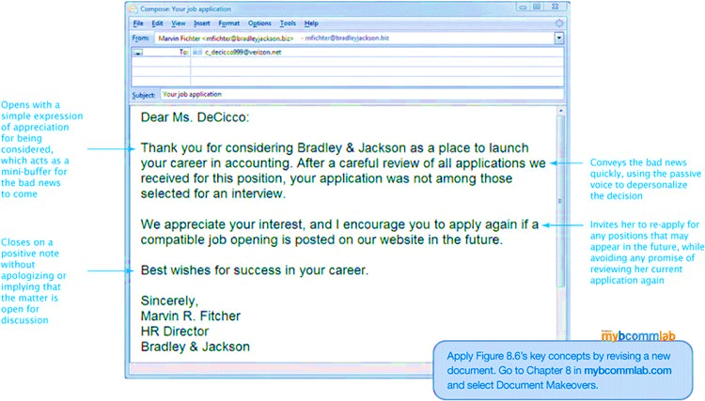
© Prentice Hall, 2004
Business Communication Essentials
Chapter 8 - ‹#›

Slide 28
Performance Reviews
Review Job
Requirements
Provide
Feedback
Develop a
Plan of Action
© Prentice Hall, 2004
Business Communication Essentials
Chapter 8 - ‹#›
Notes:
‹#›
A performance review is a manager's formal or informal evaluation of an employee. Few other communication tasks require such a broad range of skills and strategy as that needed for performance reviews, whether positive or negative. The main purpose of these reviews is to improve employee performance by (1) emphasizing and clarifying job requirements, (2) giving employees feedback on their efforts toward fulfilling those requirements, and (3) guiding continued efforts by developing a plan of action, along with its rewards and opportunities.
Positive and negative performance reviews share several characteristics: The tone is objective and unbiased, the language is nonjudgmental, and the focus is problem resolution.
Be aware that employee performance reviews can play an important role in lawsuits. If you fire an employee for incompetence and the performance evaluations are all positive, the employee can sue your company, maintaining you had no cause to terminate employment. Also, your company could be sued for negligence if an injury is caused by an employee who received a negative evaluation but received no corrective action.

Slide 29
Negative Performance Reviews
Confront the problem
Plan the message
Maintain privacy
Focus on the problem
Obtain commitment
© Prentice Hall, 2004
Business Communication Essentials
Chapter 8 - ‹#›
Notes:
‹#›

